Slide 1

GAS LEAKAGE DETECTOR
St. Francis Institute of Technology
Information Technology
IoT Mini Project (ITL504)
NEIL FERNANDO 35
CYRUS FERREIRA 36
ORPHEUS GONSALVES 41

Slide 2
Overview
Introduction
Literature survey
Problem statement
System design
Circuit diagram
System requirements
Conclusion
References

Slide 3
Introduction
1.INTRODUCTION TO THE DOMAIN
The Internet of Things (IOT) is the network of physical objects or "things" embedded with electronics, software, sensors, and network connectivity, which enables these objects to collect and exchange data
An IOT system consists of sensors/devices which “talk” to the cloud through some kind of connectivity. Once the data gets to the cloud, software processes it and then might decide to perform an action, such as sending an alert or automatically adjusting the sensors/devices without the need for the user.

Slide 4
2.BRIEF DISCUSSION ABOUT THE PROBLEM
Gas leakage leads to various causality resulting into both financial loss as well as human life. Many accidents occur in day to day life like explosion because of LPG leakage. Major harm is caused, if gas leakage is not detected early.
Every part of the society is affected due to the gas leakage. The explosion can lead to blowing of an Entire household thus damaging even the neighbouring surrounding.
A gas leak can lead to fires and explosions and if gas is not burned completely it can lead to carbon monoxide poisoning. According to Gas Safe Register (GSR), in the past three years one in six homes inspected by the organisation had an unsafe gas appliance. AND TALKING ABOUT THE EXTENT OF DAMAGE a gas leak explosion can cause the entire house to blow up causing a major explosion.
The person in the radius of 20-30M of the gas explosion can face serious injuries and it may even lead to the death of the individual.

Slide 5
THE SUPPORTING STATISTICS
According to the Labor and Employment Ministry With high industrial growth, India is also witnessing increasing number of industrial accidents and related fatalities. In just two years - 2014-2016 – factory accidents have killed 3,562 workers and injured over 51,000, according to the Labour and Employment Ministry. It means an average of three deaths and 47 injuries every day

Slide 6
3. PROPOSED SOLUTION
The world has been moving at a fast pace to adapt the smartest technologies and connect everything, means everything. Various places like hotels, canteens, industries make use of flammable gases, for example, LPG, carbon dioxide, ammonia etc. to cater the best hospitality services to their customers.
To this factor, a gas detection system was a necessity at such accident-prone locations so that the continuous monitoring of any kind of leakage can be detected irrespective of the human senses. The designed system continuously monitors the surroundings for any leakage and will send the alert to the user.

Slide 7
Literature Survey
REFERENCES | METHODOLOGY | ADVANTAGES | FUTURE SCOPE
[1] | Cloud connected smart Lpg gas cylinder acts as a safety device. If an abnormal condition is sensed the system sends messages to the user and it also generates an email to the authorities. | If the proposed design senses an accident it not only sends messages but can also take precautionary measures like closing the valve itself. | Not mentioned.
[2] | The MQ-6 gas sensor is used to sense the leakage and the GSM module sends message to the user on detecting a leakage. | The system on detecting an abnormal condition can close the regulator and also only the required amount of gas is fed into the container. | The motor used in the design can be replaced as it gets heated up very easily.
[3] | The V-model technique was used to acquire the project. This technique is very easy to apprehend and utilize.. The V-Model is based on the relationship of a testing stage for each corresponding improvement level. This means that for every single segment in the improvement drive, there is a directly correlated testing phase | Generate Sound Alarm when gas outflow is noticed, and Transmit SMS Alert to consent person, | The system can be added with multiple gas detecting sensors which can be placed in different places of a house ,market or school.
[4] | An embedded system for Gas Cylinder maintenance, the proposed system consists of three main modules a GSM and PIC module, leakage detection module and protection circuitry. The detection module detect the gas leakage and sends SMS to the consumer through GSM. | Displaying gas outflow status that signifies if the gas is in normal stage or not. | The system can be further modified such that as soon as there is a detection of gas, the system cuts the gas source off so that no further leakage happens.

Slide 8
REFERENCES
[1] Kumar Keshamoni and Sabbani Hemant. "Smart Gas Level Monitoring, Booking & Gas Leakage Detector over IOT " International Advance Computing Conference IEEE, 2017.
[2] International Journal of Advanced Research in Computer and Communication Engineering, IJARCCE, 4(1), January 2015.
[3]https://www.researchgate.net/publication/319622819_GSM_b
[4] B.Sonkar, A.Sood, A.Ranjan, and A.Faisal, "Microcontroller Based LPG Leakage Detector Using GSM Module, "International Journal of Electrical and Electronics Research, vol. III, pp. 264-269, 2015.

Slide 9
Problem Statement
To develop an IOT based Gas leakage Detector Security system in every place possible to avoid accidents and minimize the damage done. This system uses Arduino, GSM module, sensors and LCD display.
On detecting the leakage of gas a message will be sent over the internet to the Owner of the system alerting him about the leak.

Slide 10
System Design
MQ5 GAS SENSOR
GAS GGSM MODULE
OWNER
ARDUINO UNO
LCD DISPLAY
POTENTIOMETER

Slide 11
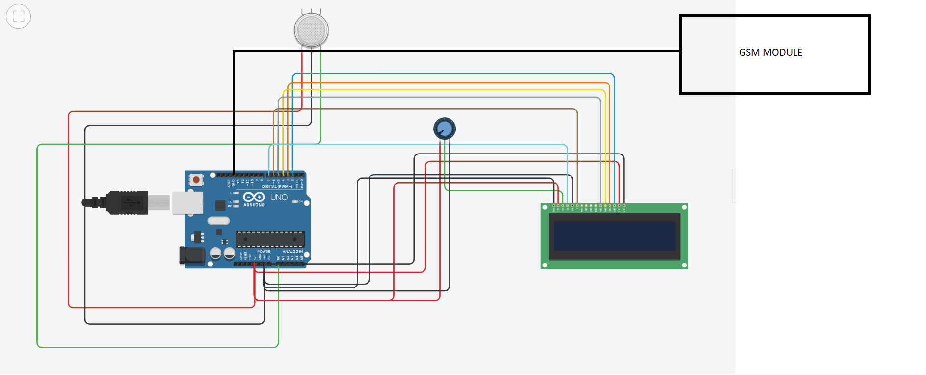
Circuit Diagram

Slide 12
System Requirements
 | Hardware requirements
Sr. No. | Component | Numbers | Cost (Rs.)
1 | Bread board | 1 | 158
2 | GSM module | 1 | 930
3 | LCD display | 1 | 200
4 | Arduino uno 3 | 1 | 550
5 | Potentiometer | 1 | 60
6 | Arduino compatible gas sensor | 1 | 210
7 | Jumper wires | 120 | 236
8
 | Software requirements
 | Software | --- | Cost
1 | OS: WINDOWS 10 | -- | ---
2 | For Website development: Node.js , React.js | -- | ---
3 | For machine learning algorithm: Python 3 | -- | ---
4 | Arduino IDE | -- | ---
 | Total |  | 2600
Conclusion: We are proposing to develop Gas leakage detector The total expected cost of this project is Rs.2600. The project is expected to be completed in all respects by October 31, 2020.

Slide 13
Conclusion

Slide 14
References

